Slide 1
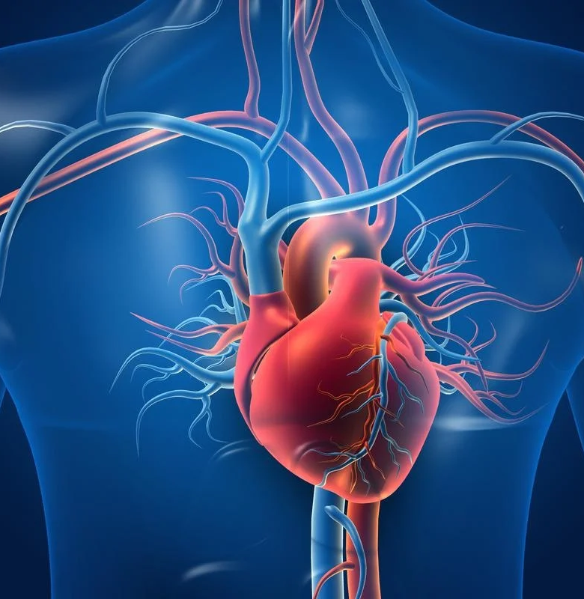
STATISTICAL ANALYSIS & modelling OF CARDIOVASCULAR PATIENTS HOSPITAL ADMISSION
GROUP 3:
Carlos Magno Nascimento
Ekpo Archibong Md Athar Khan Md. Sajid Shaila Hossain

Slide 2

Agenda
Introduction
Dataset description
Description of Some Variables
Research questions
Data wrangling
Statistical methods utilized
Analysis
Conclusion

Slide 3

Introduction- Why focus on the heart?
Heart is at the focal point of the human body
It pumps blood throughout the body keeping us alive.
Cardiovascular disease is one of the leading causes of death globally.

Slide 4
Dataset Description
Available in the Kaggle portal.
Collected from patients admitted from 2017 to 2019 at Hero DMC Heart Institute, India.
DATASET | ATTRIBUTES | DESCRIPTION | VARIABLE TYPE
HDHI Admission data | Rows:15757, Columns:56 File Type: CSV | Dataset were related to patients date of admission and discharge demographics type of admission and outcome patient history such as smoking, alcohol, hypertension. lab parameters such as hemoglobin, platelets, glucose, urea, creatinine. Other 28 features including heart failure, acute kidney disease. | Categorical: 40 Numerical: 16
DATASET | ATTRIBUTES | DESCRIPTION
Table Headings | Rows: 57, Columns:2 File Type: CSV | This data table has the descriptive headlines for all columns for the HDHI Admission data file.

Slide 5
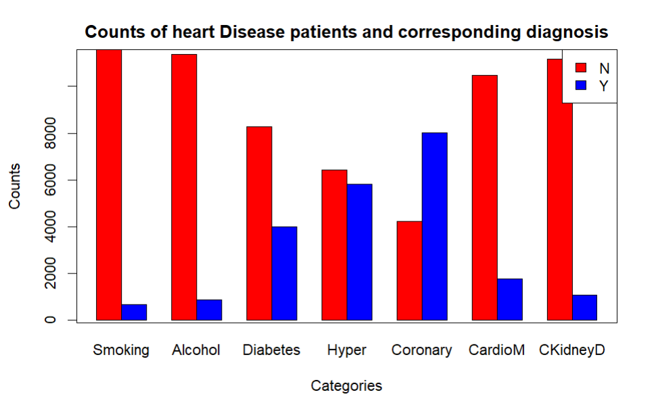
Description of Some Variables
Quantitatives:
DURATION.OF.STAY (days)
AGE (years)
GLUCOSE (mg/dL)
HB = Haemoglobin (g/dL)
TLC = TOTAL LEUKOCYTES COUNT (units)
CREATININE (mg/dL)
UREA (mg/dL)
EF = Ejection Fraction (%)
PLATELETS (units)
Qualitatives:
HEART.FAILURE (Y,N)
AKI = ACUTE KIDNEY INJURY (Y,N)
OUTCOME (EXPIRY = died, DISCHARGE by Doctor Approval, DAMA = Discharge without approval)
GENDER (M,F)
RAISED.CARDIAC.ENZYMES (Y,N)
PRIOR.CMP = CARDIOMYOPATHY (Y,N)
STEMI = ST ELEVATION MYOCARDIAL INFARCTION (Y,N)
DM = Diabetes Mellitus (Y,N)
HTN = Hypertension (Y,N)
CAD = Coronary Artery Disease (Y,N)

Slide 6
Research Questions
Which independent variables are the most important to predict heart failure and acute kidney injury (AKI)?
Which statistical learning method best predicts heart failure and AKI in terms of misclassification rate?
What would be the true mean of duration of patients stay compared with the means by using different sampling methods (SRS, and stratified sampling)?
Can we use simple Linear Regression to predict a patient’s “Duration of Stay” in admission from lab test results and gender?
In terms of misclassification rate which model best predicts the 3 levels of the variable OUTCOME (Expiry, Discharge, DAMA) ?

Slide 7
Data Wrangling
Steps taken to clean the dataset are the following:
Phase 1
Phase 2
Phase 3
Deleting date columns to remove time-based dependency.
Removing duplicates.
Removing null values.
Removing unwanted columns based on count.
Factorizing categorical columns
Converting character into integers for numeric columns
Separating categorical variables for further analysis.
Separating numerical and few categorical variables for analysis.

Slide 8

Statistical methods utilized
SRS & Stratified
Sampling
Linear Regression
Contingency Table
Logistic Regression
LDA
QDA
Regression Tree
Classification Tree
Multinomial Regression
Cross Validation

Slide 9

ANALYSIS

Slide 10
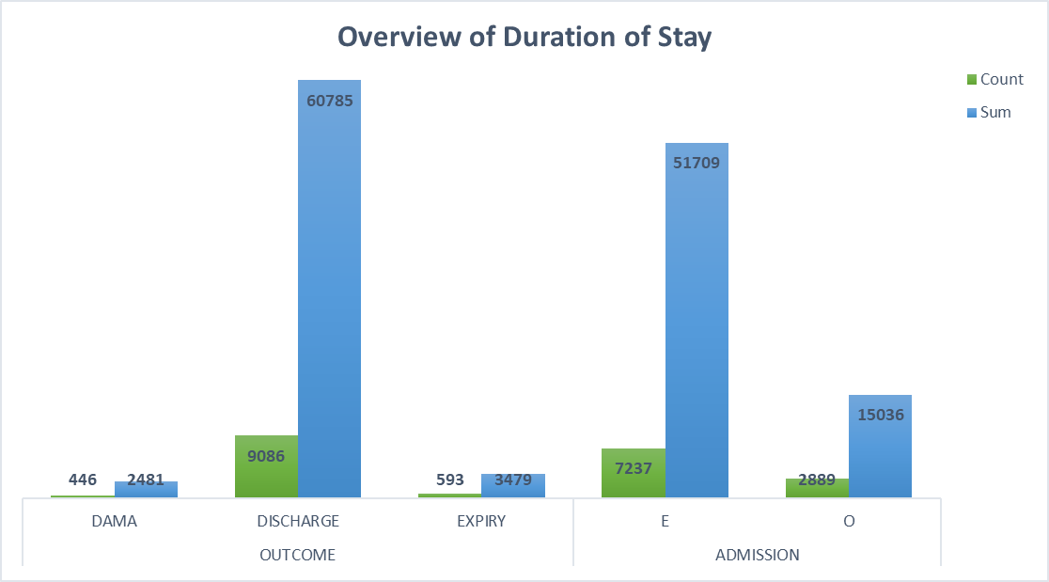
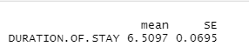
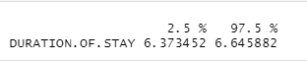
SRS & Stratified Sampling
Variable of Interest: Duration of Stay, Population size: 10125, Sample size: 3000
Simple Random Sampling

Slide 11
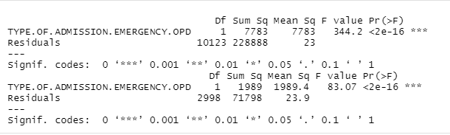
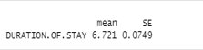
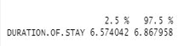
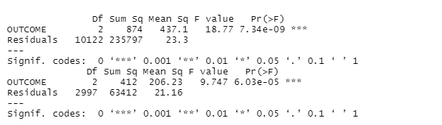
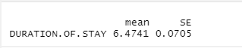
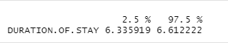
SRS & Stratified Sampling
Comparison using Anova
Stratified Sampling
Stratum: Type of Admission (Emergency, OPD)
Type of Admission
Stratified Sampling
Stratum: Outcome
(DAMA, Discharge, Expiry)
Outcome
Type | Mean
Population | 6.5935
SRS | 6.5097
Stratified(Admission) | 6.721
Stratified(Outcome) | 6.4741

Slide 12
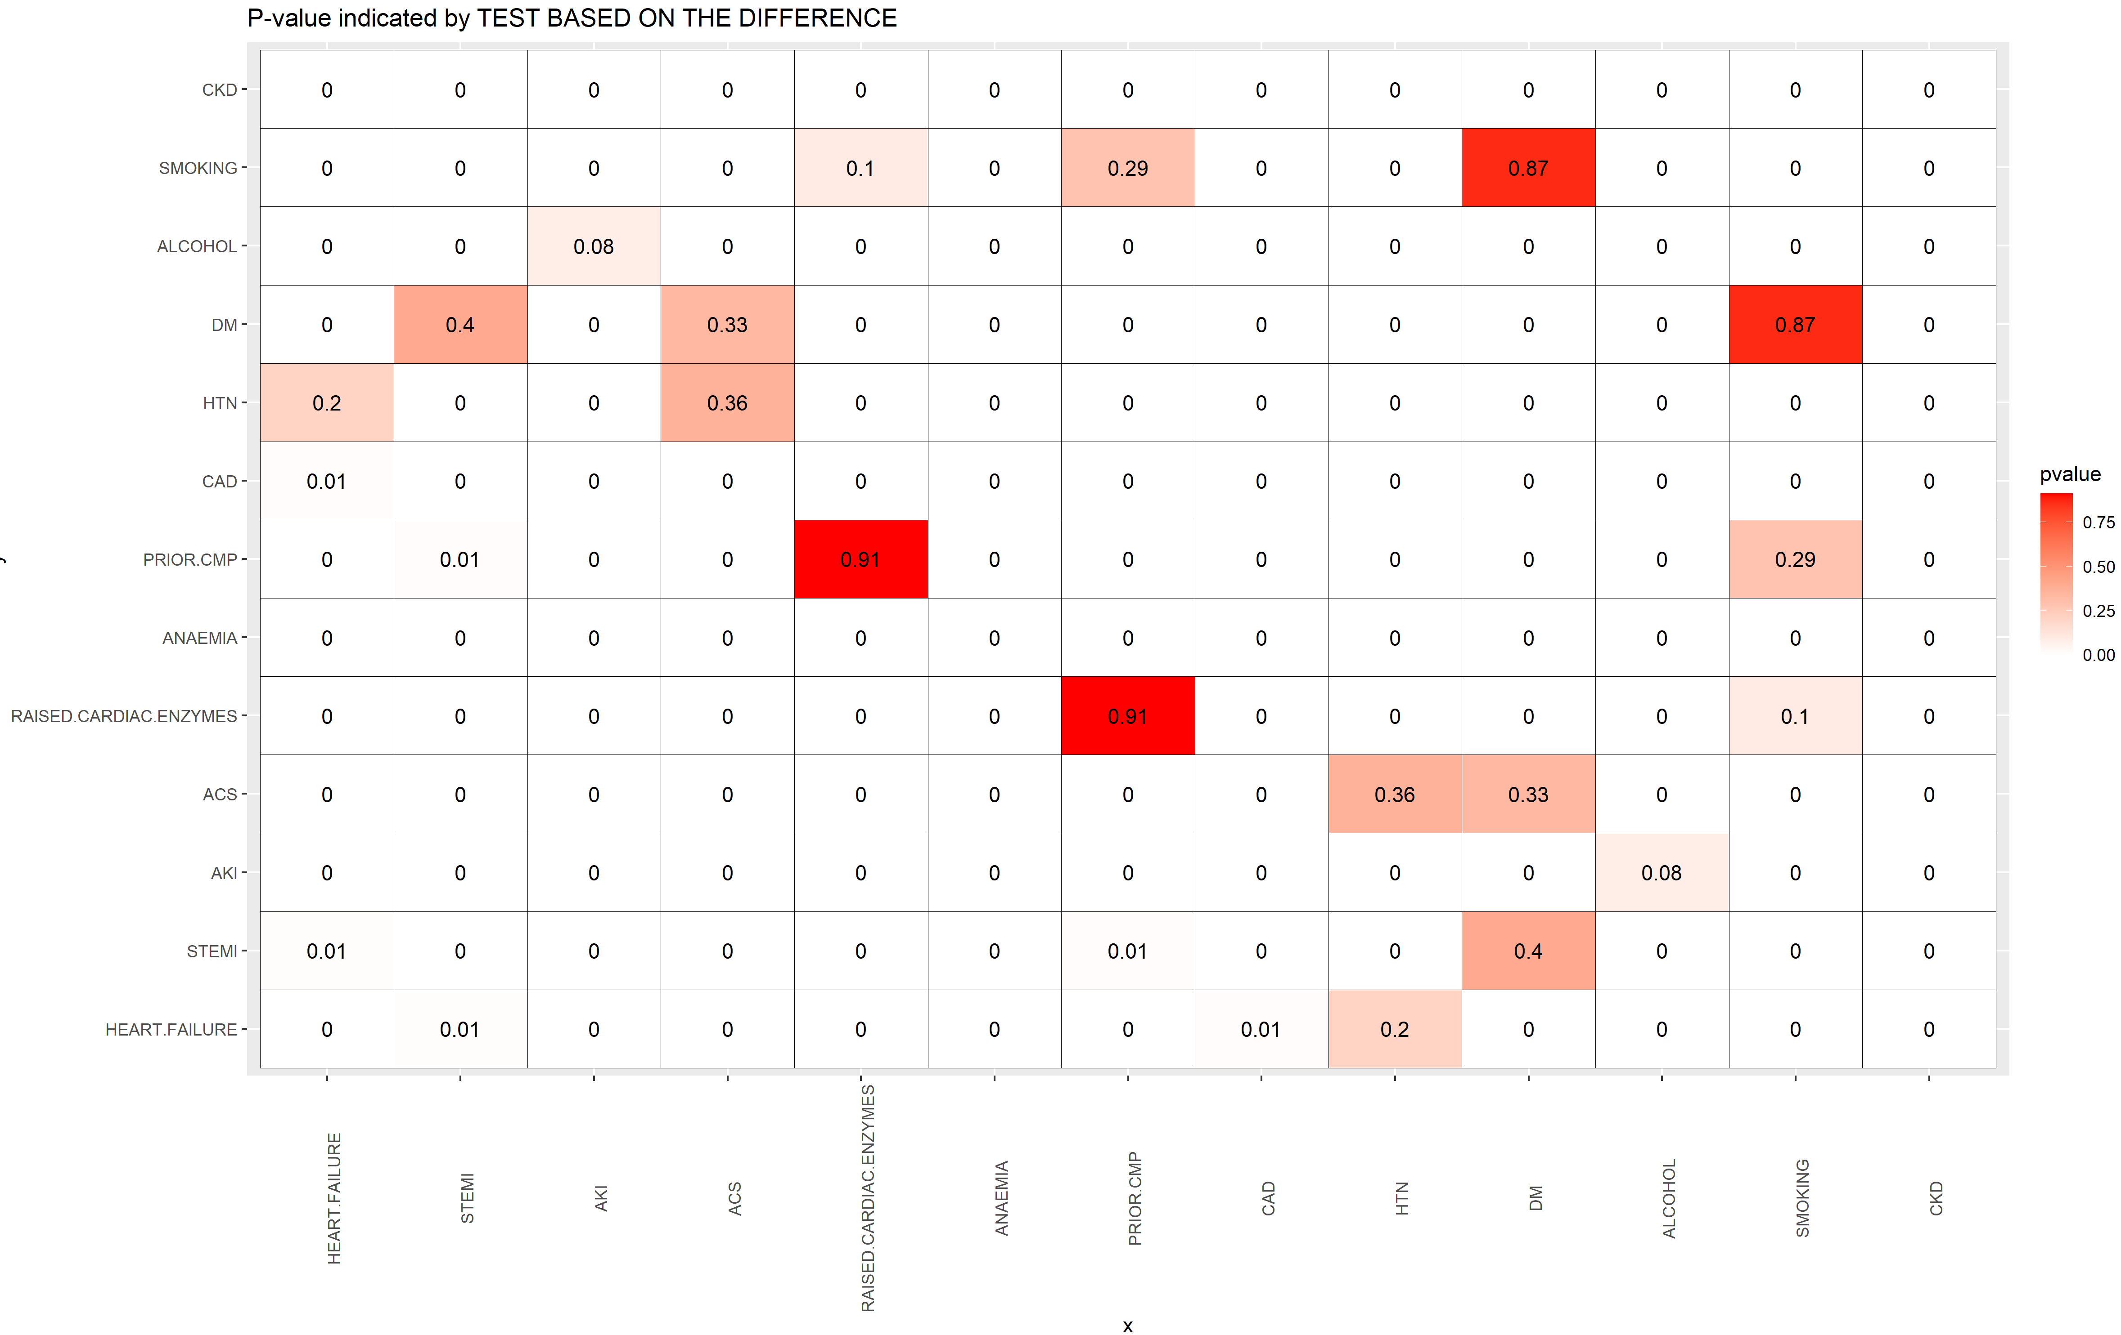
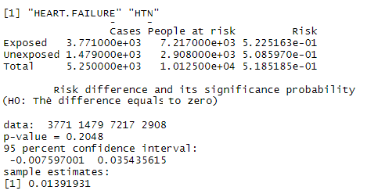
Contingency Table
Each Cell represents the p-value of 2x2 Table Contingency obtained by “Test Based on Differences”
For example, comparing HEART.FAILURE with HTN:
Based on this, HTN is independent of HEART.FAILURE
REMEMBER FOR REGRESSION:
Response variable is function of dependent variables, whereas the explanatory variables must be independent among them !
Based on this, there are different possibilities for modelling, for example:
1.A) HEART.FAILURE in function of ACS and DM
1.B) HEART.FAILURE in function of STEMI and DM
1.C) HEART.FAILURE in function of AKI and ALCOHOL
1.D) HEART.FAILURE in function of RAISED.CARDIAC.ENZYMES, PRIOR.CMP and SMOKING
1.E) HEART.FAILURE in function DM, STEMI, ACS and SMOKING
For AKI as response variable:
2.A) AKI in function of RAISED.CARDIAC.ENZYMES and PRIOR.CMP
2.B) AKI in function of STEMI and DM
2.C) AKI in function of HEART.FAILURE and HTN
2.D) AKI in function of DM, STEMI, ACS and SMOKING

Slide 13
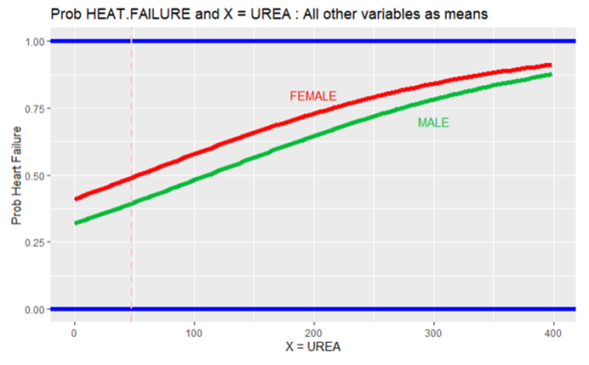
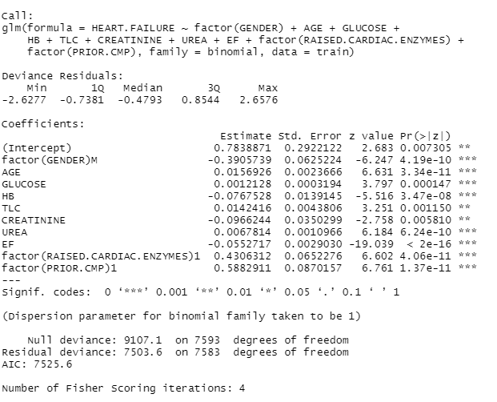
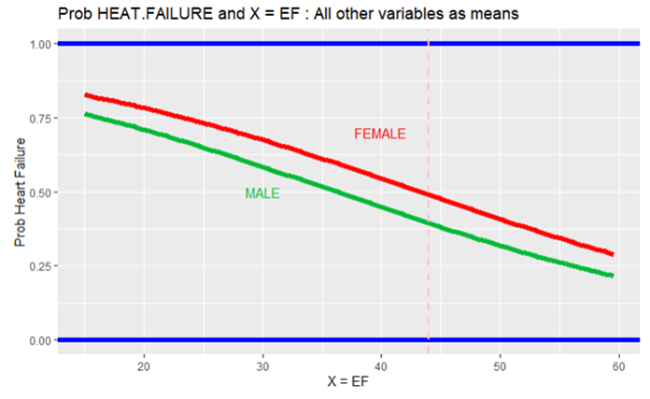
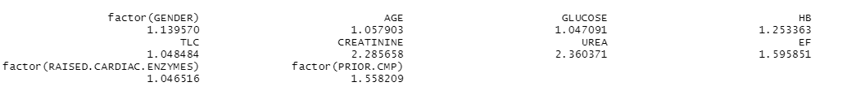
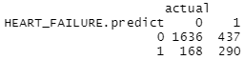
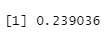
Analysis of Heart Failure – Logistic Regression
Probability considering the means/median for all the other parameters
Final model created based on Train Set (75%) with only relevant and independent variables
Mean Urea
Normal
Normal
Check of Multicollinearity
Mean EF
Only CREATININE and UREA with moderated collinearity.
Prediction based on Test part (25%)
Misclassification rate of 23.9% in the prediction of test part.

Slide 14
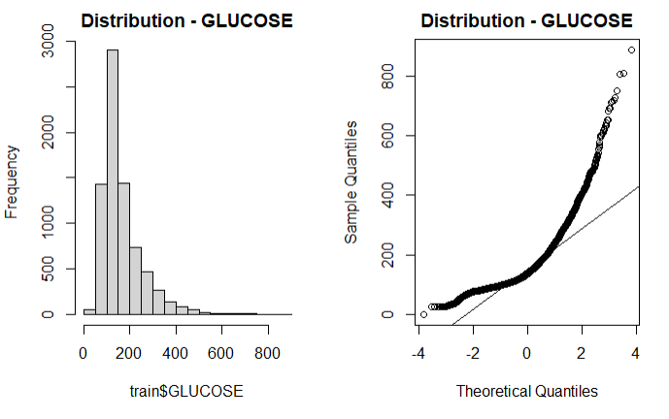
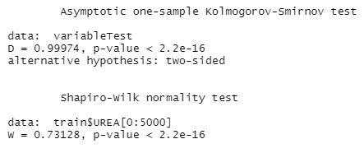
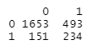
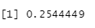
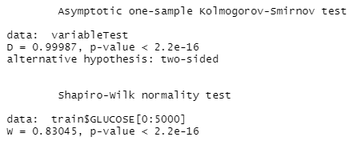
Analysis of Heart Failure – LDA
Normality Tests (Shapiro-Wilk and Kolmogorov-Smirnov) indicated that none of quantitative variables has normal distribution (they were not taken into account in LDA)
Final model created based on Train Set (75%) with only relevant and independent variables
Prediction based on Test part (25%)
Misclassification rate of 25.4% in the prediction of test part.

Slide 15
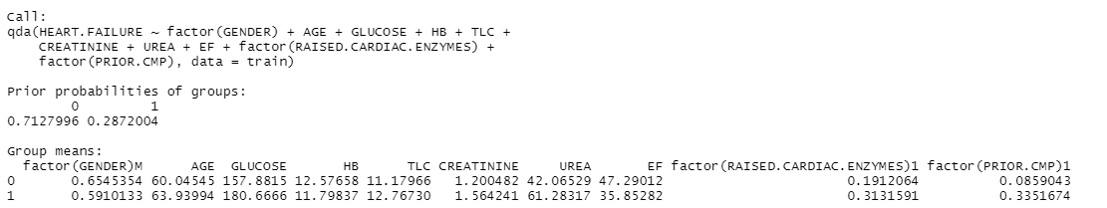
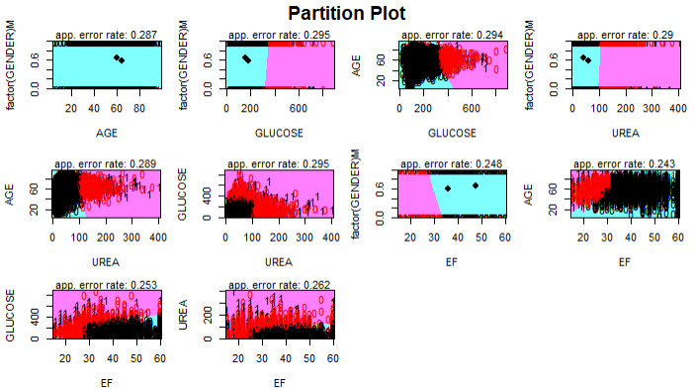
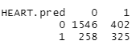
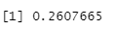
Analysis of Heart Failure – QDA
Final model created based on Train Set (75%) with only relevant and independent variables
Prediction based on Test part (25%)
Misclassification rate of 26.1% in the prediction of test part.

Slide 16
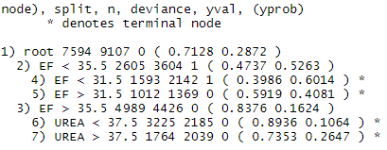
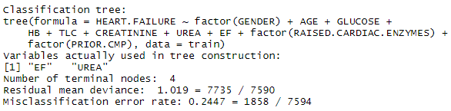
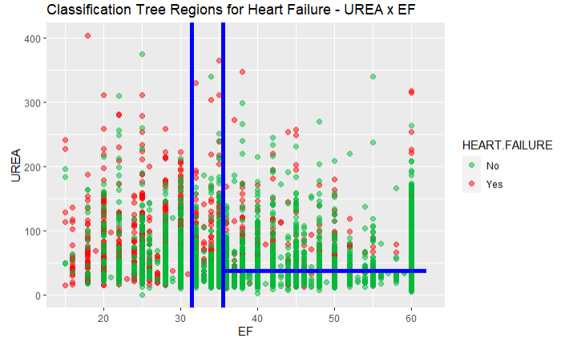
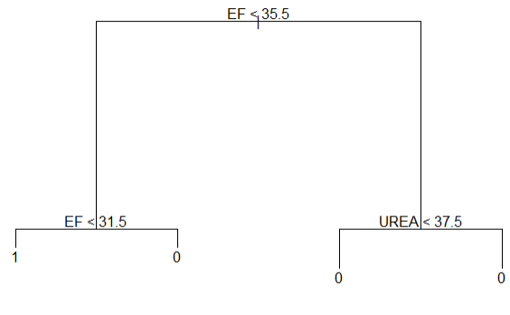
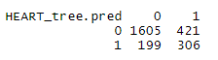
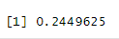
Analysis of Heart Failure – Classification Tree
Final model created based on Train Set (75%) with only relevant and independent variables
Probabilities in each node
R1
R2
R3
R4
Tree
R1
R2
R4
R3
Prediction based on Test part (25%)
R1
R2
R3
R4
Misclassification rate of 24.5% in the prediction of test part.

Slide 17
Heart Failure Analysis - Summary misclassification rate comparison
- The relevant explanatory variables used:
Quantitative: AGE, GLUCOSE, HB, TLC, CREATININE, UREA and EF
Qualitative: GENDER, RAISED.CARDIAC.ENZYMES and PRIOR.CMP
Logistic regression
23.9%
LDA *
25.4%
QDA
26.1%
Classification Tree
24.5%
Stratified Sampling (75% train, 25% test)
Logistic Regression (UREA and EF)
24.5%
Logistic regression
25.7%
LDA*
25.3%
QDA
25.7%
Classification Tree
26.4%
With 10 fold Stratified Cross Validation
26.6%
Logistic Regression (UREA and EF)
* Only qualitative variables

Slide 18
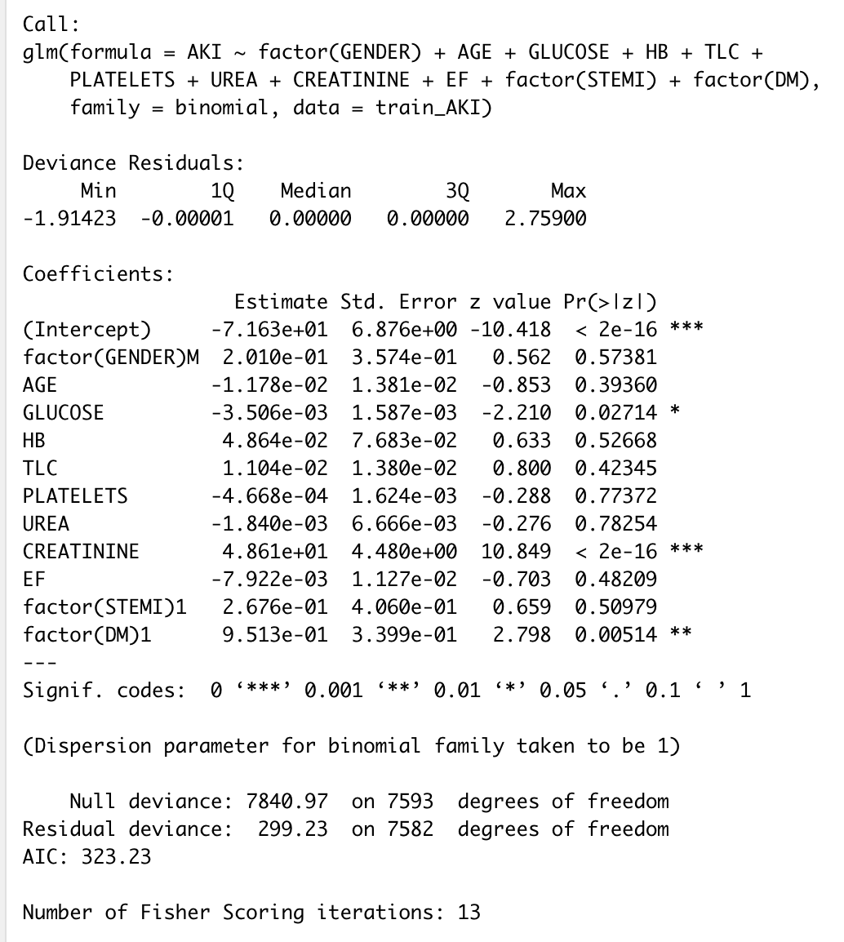
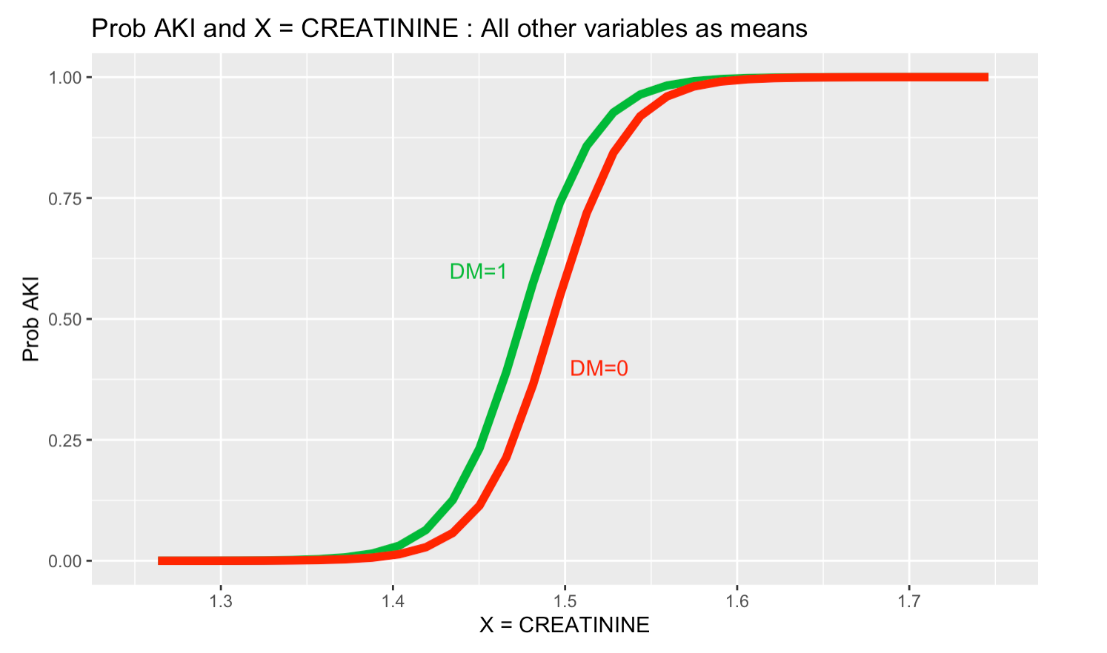
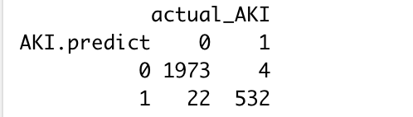
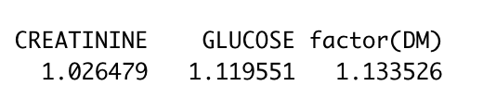
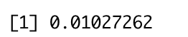
Analysis of AKI (Acute Kidney Injury) – Logistic Regression
Model
Probability considering the means/median for all the other parameters
Prediction based on Test part (25%)
Multicollinearity Checking
Misclassification rate

Slide 19
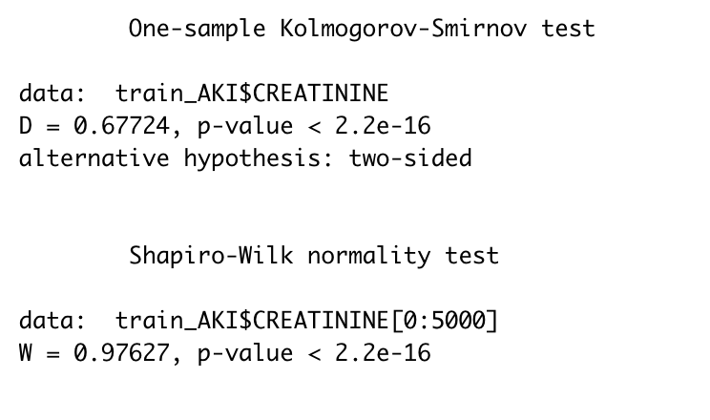
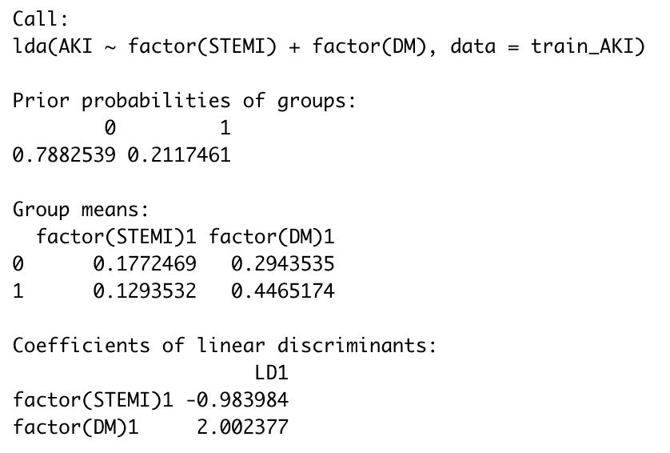
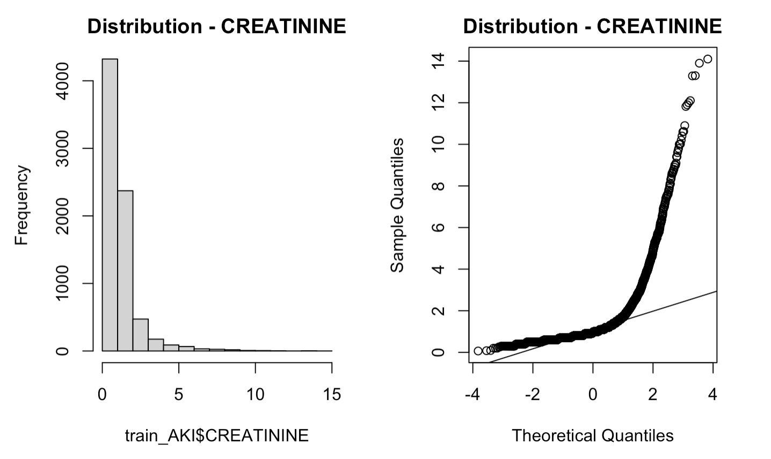
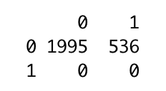
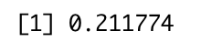
Analysis of AKI (Acute Kidney Injury) – LDA
Normality Tests (Shapiro-Wilk and Kolmogorov-Smirnov)
Model
Prediction based on Test part (25%)
Misclassification rate

Slide 20
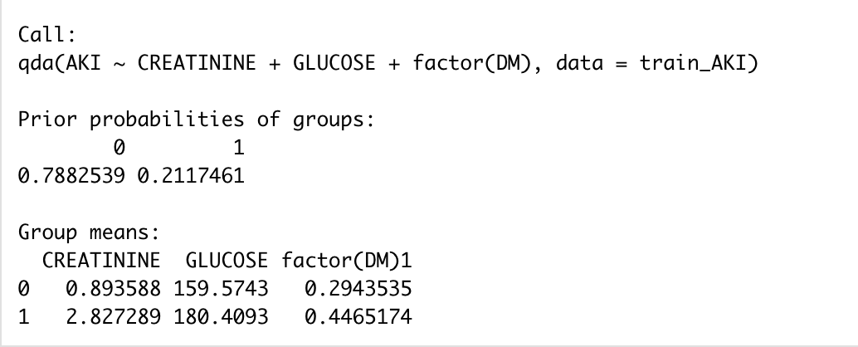
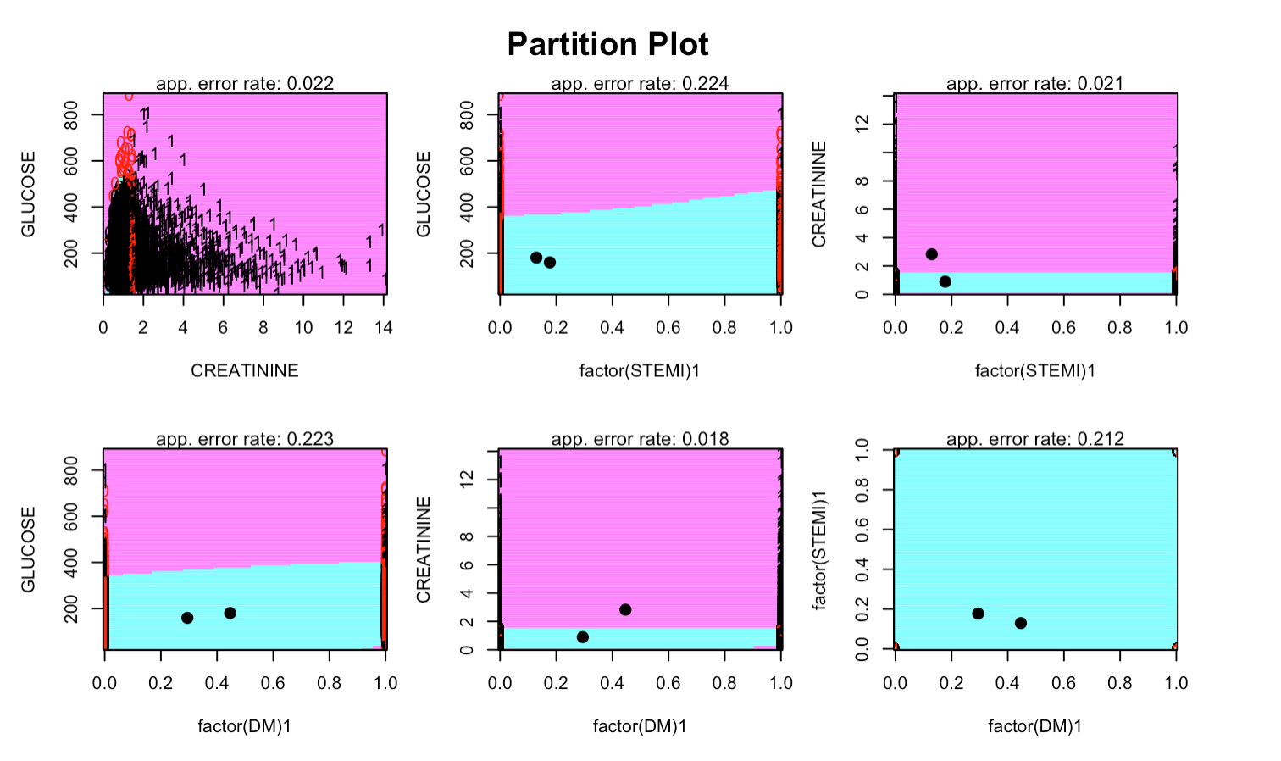
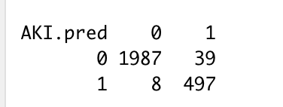
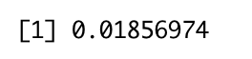
Analysis of AKI (Acute Kidney Injury) – QDA
QDA Model
Prediction based on Test part (25%)
Misclassification rate

Slide 21
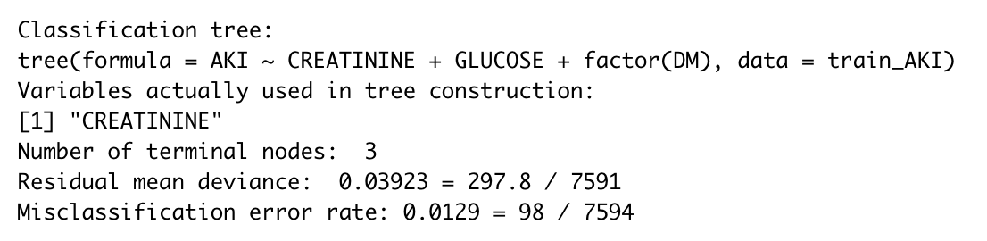
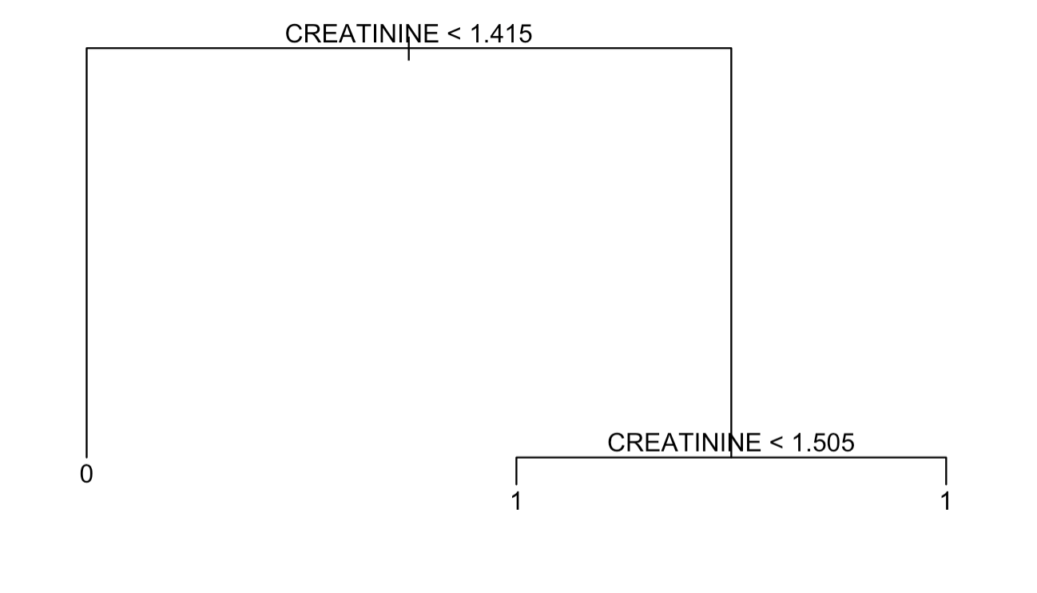




Analysis of AKI (Acute Kidney Injury) – Classification Tree
Model
Tree
Misclassification rate
Prediction
Probabilities in each terminal node

Slide 22
Analysis of Acute Kidney Injury - Summary misclassification rate comparison
- The relevant explanatory variables used:
Quantitative: GLUCOSE and CREATININE
Qualitative: DM and STEMI
Logistic regression
1.03%
LDA*
21.2%
QDA
1.86%
Classification Tree
1.3%
Stratified Sampling (75% train, 25% test)
Logistic regression
1.11%
LDA*
21.2%
QDA
2.34%
Classification Tree
1.33%
With 10 fold Stratified Cross Validation
* Only qualitative variables

Slide 23


Linear Regression

Slide 24





Linear Regression
R- squared = 7.2%
Residual Standard Error = 4.66
p-value: < 2.2e-16
Cook’s Distance < 0.2

Slide 25




Linear Regression comparison with Regression Tree
Residual Standard Error
75% Training Set and 25% Test Set
RSE of Tree on test Set= 5.01
RSE of LM = 4.66
10 Folds CV
RSE of Tree = 4.69
RSE of LM = 4.64
TLC = Total Leukocytes Count

Slide 26

Multinomial Regression
The response/dependent variable is the OUTCOME with 3 levels Discharge, Expiry and DAMA.
Taking patients that have died i.e., Expiry as the reference value.
Variables that are statistically significant i.e., p-value <0.05 and provide us 95% confidence level
Age - Coronary Artery Disease(CAD)
Ejection Fraction(EF) - PLATELETS
Total Leukocytes Count(TLC). - GLUCOSE
Hemoglobin(HB) - UREA
Duration of Stay - STABLE.ANGINA
Alcohol - Acute Coronary Syndrome
Smoking - STEMI
Diabetes Mellitus(DM). - Chronic Kidney Disease
The Multinomial logistic Model runs 60 iterations for reducing error

Slide 27


Multinomial Regression
Confusion Matrix for Training Data
Confusion Matrix for Test Data​
Misclassification Error rate for Training Data is 9.30%
Misclassification Error rate for Test Data​ is 9.33%

Slide 28



Comparison between Multinomial Regression and Classification Tree
Classification Tree (without pruning)
Cross Validation Error by pruning the tree
Node Probabilities (without pruning)
Based on the cv.error, it looks like the cv.error with 4 terminal nodes is similar to 6. Based on this, let prune the tree to 4 terminal nodes.
Misclassification Rate:
Without Pruning: 8.9%
With Pruning (4 terminal nodes): 10%
The majority of terminal nodes with more than 70% for the class indicated by the tree. In addition, the tree model will never predict DAMA.

Slide 29

Conclusions
SRS is better option for this dataset compared to stratified sampling when compared with the population mean.
Analysis of independence using Table Contingency helped to select categorical exploratory variables that it would be independent among them, but at the same time dependent of the response variable.
For HEART.FAILURE prediction the best model (misclassification rate of 23.9%) was obtained with LOGISTIC REGRESSION without cross validation.
For Acute Kidney Injury (AKI) prediction the best model (misclassification rate of 1.03%) was obtained with LOGISTIC REGRESSION without cross validation.
Duration of stay was not successfully predicted with both linear regression and regression tree using the quantitative variables.
Multinomial regression was successful in predicting all 3 stages of Outcome (misclassification rate of 9.3%).

Slide 30

Thank You

Slide 31

ANY QUESTIONS?

Slide 32
References
Hospital Admissions Data, Kaggle. Available at https://www.kaggle.com/datasets/ashishsahani/hospital-admissions-data/discussion/302894?resource=download&select=HDHI+Admission+data.csv (accessed on Jan. 25,2023).
Bollepalli, S.C.; Sahani, A.K.; Aslam, N.; Mohan, B.; Kulkarni, K.; Goyal, A.; Singh, B.; Singh, G.; Mittal, A.; Tandon, R.; Chhabra, S.T.; Wander, G.S.; Armoundas, A.A. An Optimized Machine Learning Model Accurately Predicts In-Hospital Outcomes at Admission to a Cardiac Unit. December 12,2022, Kaggle. Available at https://doi.org/10.3390/diagnostics12020241 (accessed on Jan. 30,2023).
Attribution-NonCommercial-ShareAlike 4.0 International (CC BY-NC-SA 4.0),Creative Commons, Available at https://creativecommons.org/licenses/by-nc-sa/4.0/ (accessed on Jan. 30,2023).
Leading causes of death, February 22,2022, Open Canada-Government of Alberta. Available at https://open.canada.ca/data/en/dataset/03339dc5-fb51-4552-97c7-853688fc428d (accessed on Jan. 28,2023).

